Slide 1
제 8회 인공지능 및 로보틱스 여름학교 AI & Robotics Summer School 2023 딥러닝 실습 1 - Classification
AILAB
School of Integrated Technology (SIT)
Gwangju Institute of Science and Technology (GIST)

Slide 2
Contents
1. Overview
2. Trainer
2.1 Custom CNN Model
2.2 Predefined Model
2.3 Loss
2.4 Optimizer
2.5 Mini Batch
2.6 Batch size and Learning Rate
3. Loader
3.1 Data Preparation
3.2 Dataset
3.3 Augmentation
3.4 Data Loader
4. Train & Evaluation
4.1 Train From Scratch
4.2 Train Predefined Model
4.3 Tuning Pretrained Model

Slide 3
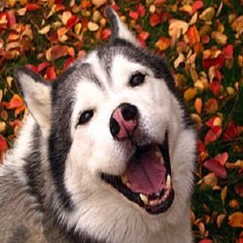
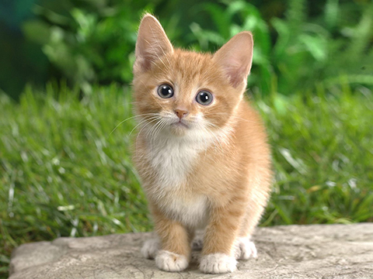
Overview
Classification is one of the fundamental task in computer vision which for predicting given images to predefined classes or categories.
As an example below, if there is dataset included images of dogs and cats, make model to be able to classify dogs and cats by training with dataset is one case of classification task.
In this chapter we will train model for classification using by open dataset and predefined model.
Output
DOG
DOG
CAT
Dataset
Network

Slide 4
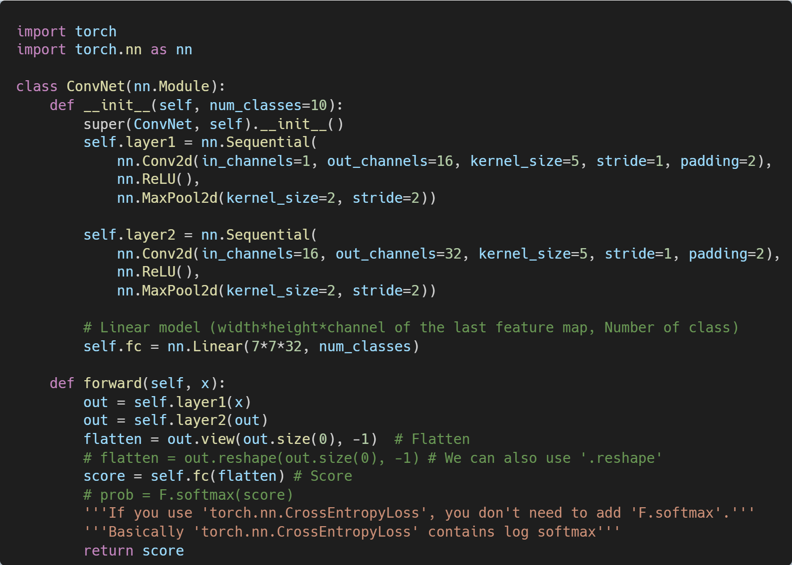
Trainer
Custom CNN Model
We can make CNN model by inherit ‘nn.Module’ in Pytorch.
To make basic CNN we need to define ‘__init__’ and ‘forward’ methods.
‘__init__’ is method is a method that automatically called when a new instance of the class is created for initialize the attributes of the object.
To inherit nn.Module calling super method is necessary.
CNN for classification generally builds up several convolutional layers and using fully connected layer(Linear) at last to predict a class.
‘forward’ is method that define the computation performed when an instance of the class is called as a function.
In ‘forward’, input go through the convolution layers and after linear layer, but before entering the linear layer flatten is required.
Also, softmax is needed if the loss function is not Cross Entropy Loss.

Slide 5
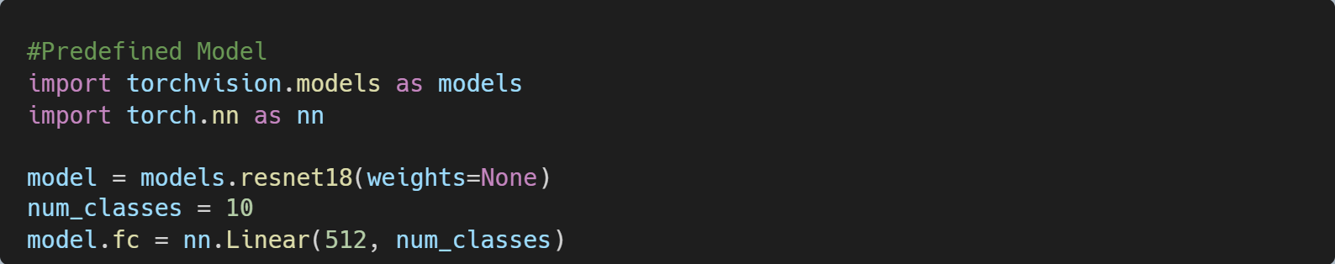
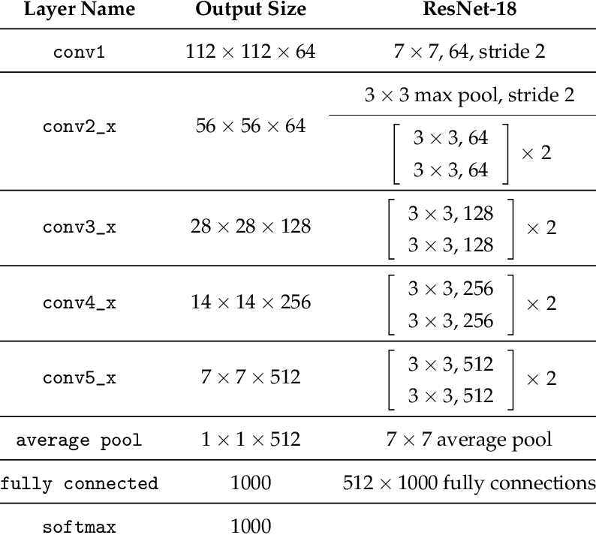
Trainer
Predefined Model
Torchvision provides several predefined models.
You can use predefined models by importing ‘torchvision.models’.
If you want ImageNet pretrained parameter for model weight, change pretrained parameter in model to True.
Because default output size of model would be different with number of classes in dataset we will used, changing the model output size to the number of classes in the dataset is required.
ResNet18 Structure
https://www.researchgate.net/figure/ResNet-18-Architecture_tbl1_322476121

Slide 6
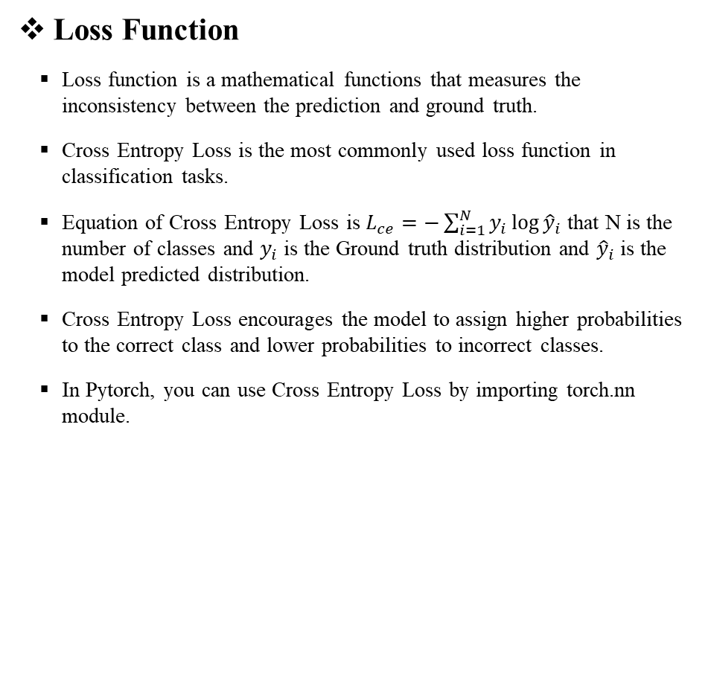
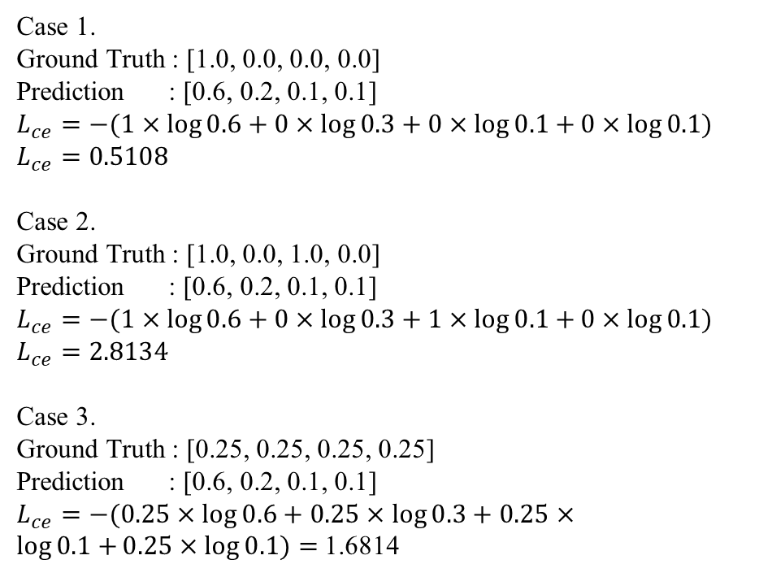
Trainer
Loss Function
Loss function is a mathematical functions that measures the inconsistency between the prediction and ground truth.
Cross Entropy Loss is the most commonly used loss function in classification tasks.
Equation of Cross Entropy Loss is $L_{ce}=−\sum_{i=1}^{N}{y_{i}\log{{\hat{y}}_{i}}}$ that N is the number of classes and $y_{i}$ is the Ground truth distribution and ${\hat{y}}_{i}$ is the model predicted distribution.
Cross Entropy Loss encourages the model to assign higher probabilities to the correct class and lower probabilities to incorrect classes.
In Pytorch, you can use Cross Entropy Loss by importing torch.nn module.
Case 1.
Ground Truth : [1.0, 0.0, 0.0, 0.0]
Prediction : [0.6, 0.2, 0.1, 0.1]
$$L_{ce}=−(1×\log{0.6}+0×\log{0.3}+0×\log{0.1+}0×\log{0.1)}$$
$$L_{ce}=0.5108$$
Case 2.
Ground Truth : [1.0, 0.0, 1.0, 0.0]
Prediction : [0.6, 0.2, 0.1, 0.1]
$$L_{ce}=−(1×\log{0.6}+0×\log{0.3}+1×\log{0.1+}0×\log{0.1)}$$
$$L_{ce}=2.8134$$
Case 3.
Ground Truth : [0.25, 0.25, 0.25, 0.25]
Prediction : [0.6, 0.2, 0.1, 0.1]
$L_{ce}=−(0.25×\log{0.6}+0.25×\log{0.3}+0.25×\log{0.1+}0.25×\log{0.1)}=$1.6814

Slide 7
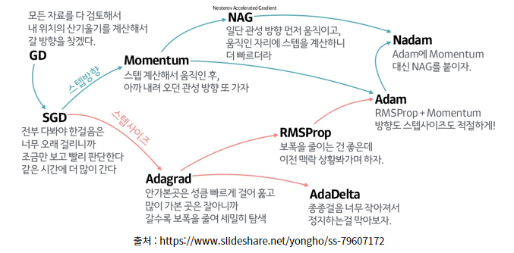
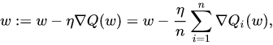
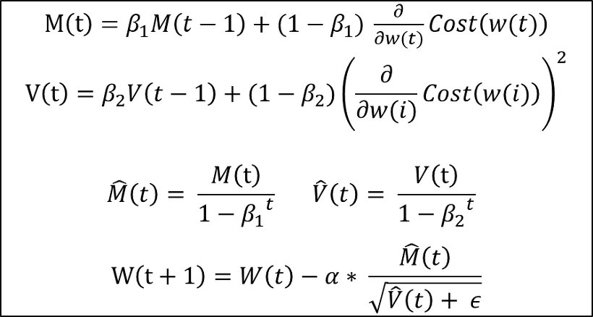
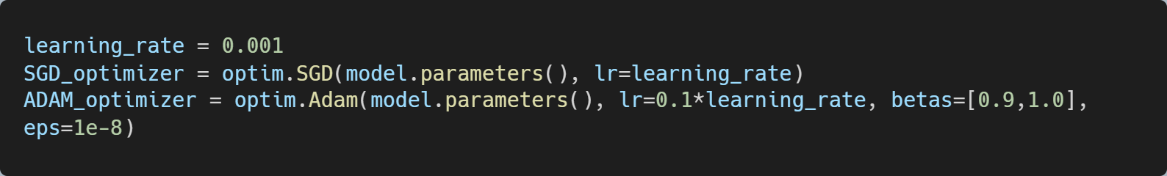
Trainer
Optimizer
Optimizer is for updating the model’s parameters based on gradients to minimize the loss function during training.
Gradient Descent optimizer updates model parameter after considering all train data.
Stochastic Gradient Descent optimizer updates model parameter using mini batches of train data to get benefit of training speed and memory efficiency.
ADAM optimizer combined benefits of adaptive learning and momentum. It adjusts the learning rate for each parameter individually based on the past gradients and their squared gradients, enabling efficient and effective optimization of the model.
You can use SGD, ADAM optimizer by importing torch.optim module.
SGD :
ADAM :
https://twinw.tistory.com/247

Slide 8
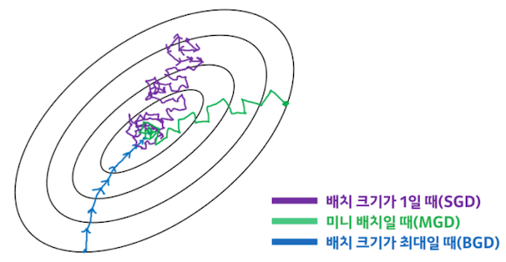
Trainer
Mini Batch
The reason why we used mini batch at deep learning is related about memory and training efficiency.
If we update the model parameter for every single data, because of lack of generality there is risk of falling into wrong local minima.
If we update the model parameter only after calculate loss of all data, it required bigger memory than data size. Also, it will take a long time to complete the training due to satisfied minimum iterations of training.
By mini batch we can trade of memory size and training time with data generality.
Batch Size 별 학습 양상
https://www.kakaobrain.com/blog/113

Slide 9
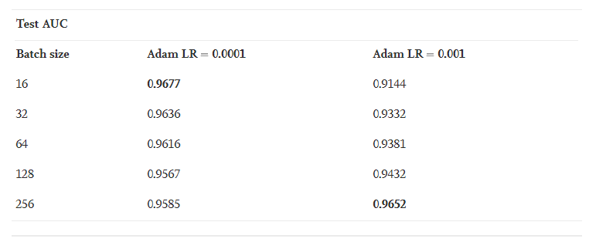
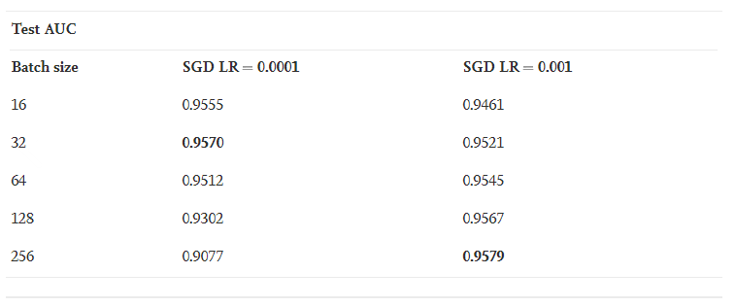
Trainer
Batch size and Learning Rate
Model : ImageNet pretrained VGG16
Dataset : PatchCamelyon (Binary)
Fine tuning : O
Result (ADAM / SGD).
Small Batch Size + Small Learning Rate : 0.9677 / 0.9555
Small Batch Size + Big Learning Rate : 0.9144 / 0.9461
Big Batch Size + Small Learning Rate : 0.9585 / 0.9077
Big Batch Size + Big Learning Rate : 0.9652 / 0.9579
If batch size is small, be learning rate small
If batch size is big, be learning rate big
www.sciencedirect.com/science/article/pii/S2405959519303455#fig2
https://inhovation97.tistory.com/32

Slide 10
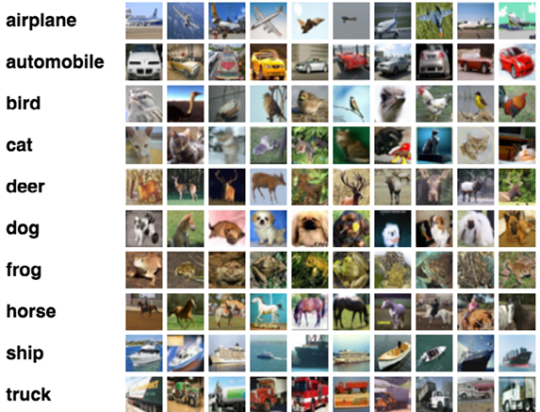
Loader
Data Preparation
There are many open benchmark datasets for classification like ImageNet, CIFAR-100, MNIST, etc.
But in this time we will use CIFAR-10 which is popular image classification dataset that included 10 different categories of images. Each class is as shown in the figure on the right.
CIFAR-10 consists of 60000 images with 6000 images per class. Of the 60000 images, 50000 are used for training and 10000 are used for evaluation. The size of the image is 32x32.
CIFAR-10

Slide 11
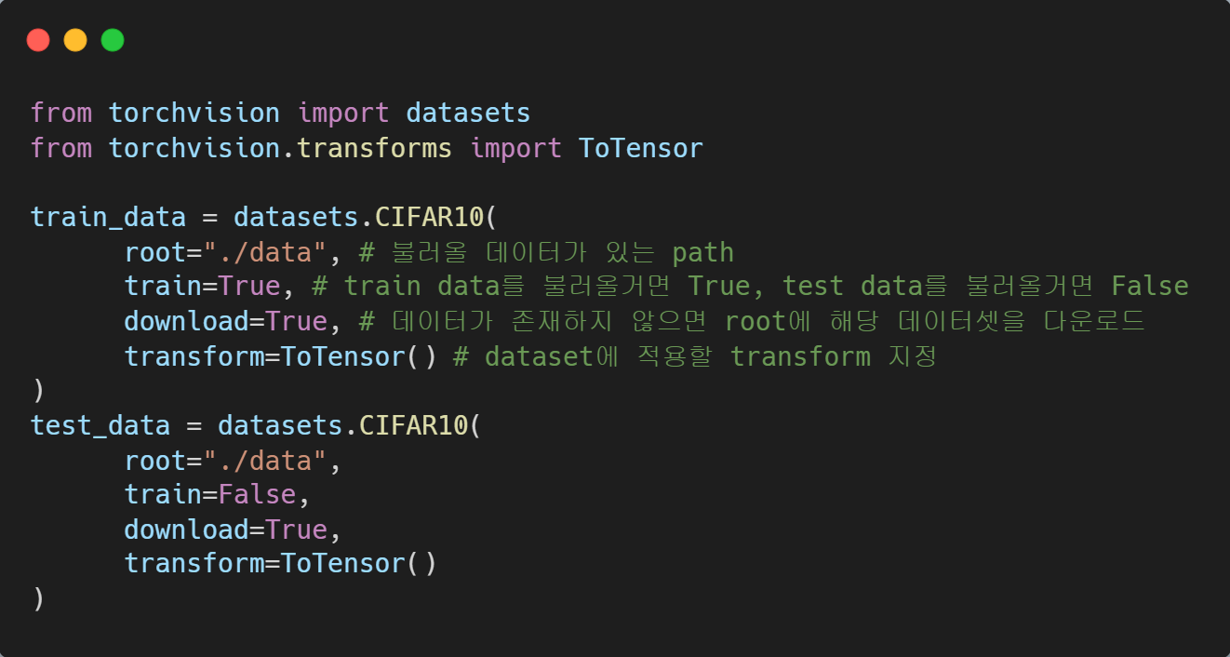
Loader
Dataset
torchvision provides several datasets including CIFAR-10 in the datasets module.
In the datasets.CIFAR10 there are parameters that ‘root’, ‘train’, ‘transform’, ‘target_transform’, and ‘download’.
‘root’ is the string variable that path of image data.
‘train’ is boolean variable. True, if data is for ‘training’ and False, if data is for ‘evaluation’.
‘download’ is boolean variable, True, if you want to download dataset if datasets are not in ‘root’ and False, if you do not want to download.
‘transform’ is function or sequence of functions that for transform images.
‘target_transform’ is fuction or sequence of functions that for transform targets.
Shape of data (tensor) is (channels, height, width)

Slide 12
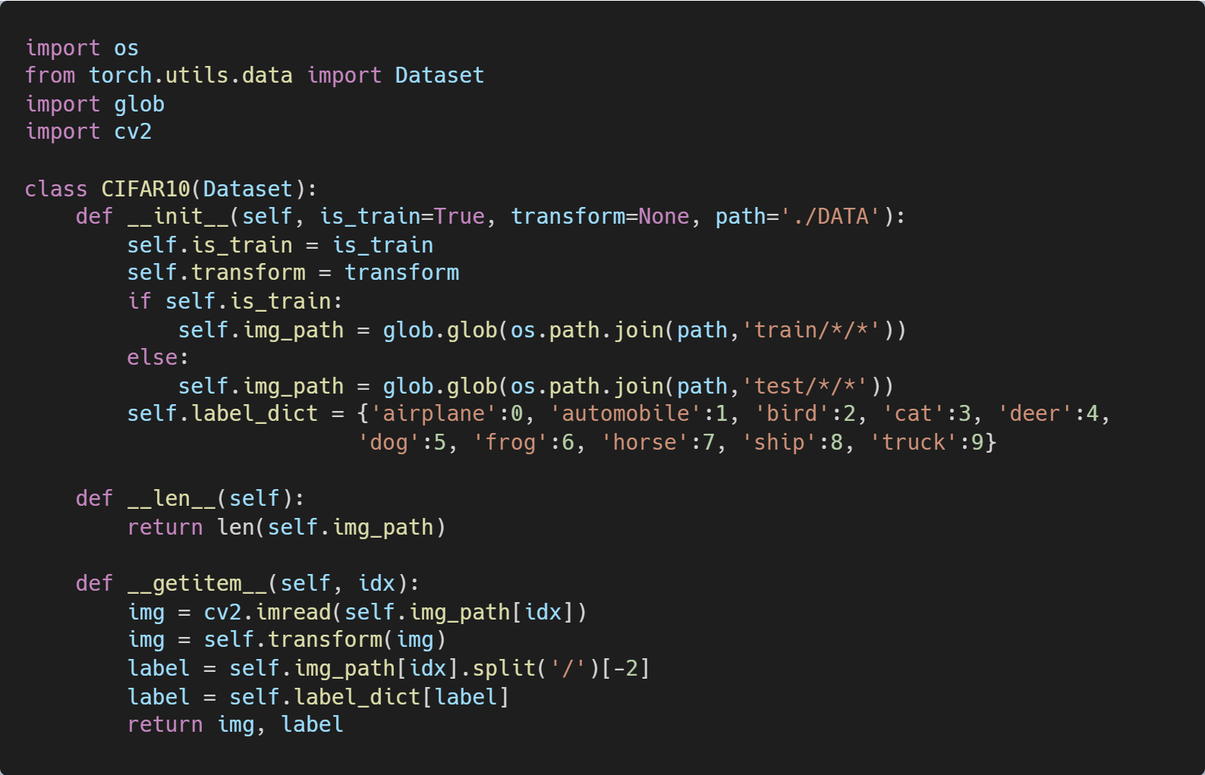
Loader
Dataset
You also can get CIFAR data from their homepage (https://www.cs.toronto.edu/~kriz/cifar.html), and make your own dataset.
To make custom dataset, you need to write __init__, __len__, and __getitem__.
In __init__, variables and datas are initialized.
In __len__, the length of dataset is defined.
In __getitem__, images are loaded, transformed and returned with corresponding label.

Slide 13
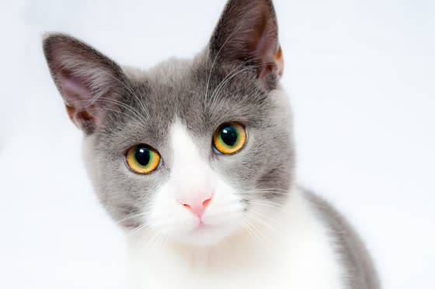
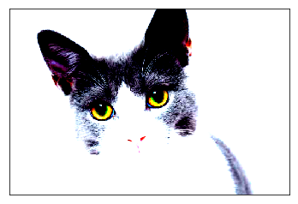
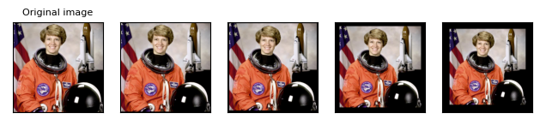
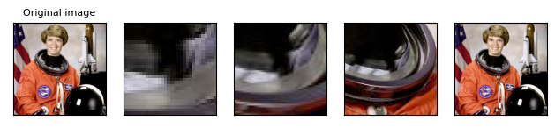
Loader
Augmentation
Augmentation is used for increasing the number of data by changing images in various ways and unifying the size and shape of data.
There are various augmentations in torchvision.transforms.
ToTensor() makes PIL image, ndarray to Tensor.
Normalize(mean, std) normalize tensor by given mean and standard deviation.
Resize(size) changes image size to given size.
CenterCrop(size) crops center of images by given size.
RandomHorizontalFlip(p) randomly flips the image horizontaly by given probability, p.
RandomVerticalFlip(p) randomly flips the image verticaly by given probability, p.
RandomRotation(degrees) rotate randomly in given ranges of degree.
GrayScale() changes images into grayscale.
Normalize
https://gist.github.com/jbencook/8340230c70c8b0716fe3a0db85fcb71c
Resize
Center Crop
https://pytorch.org/vision/0.11/auto_examples/plot_transforms.html#sphx-glr-auto-examples-plot-transforms-py

Slide 14
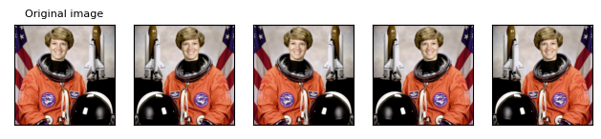
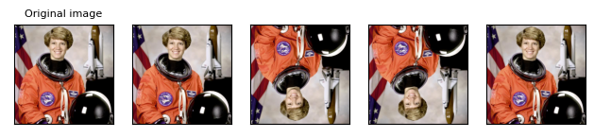
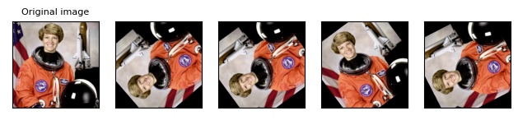
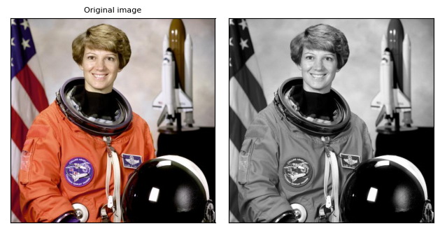
Loader
Augmentation
Augmentation is used for increasing the number of data by changing images in various ways and unifying the size and shape of data.
There are various augmentations in torchvision.transforms.
ToTensor() makes PIL image, ndarray to Tensor.
Normalize(mean, std) normalize tensor by given mean and standard deviation.
Resize(size) changes image size to given size.
CenterCrop(size) crops center of images by given size.
RandomHorizontalFlip(p) randomly flips the image horizontaly by given probability, p.
RandomVerticalFlip(p) randomly flips the image verticaly by given probability, p.
RandomRotation(degrees) rotate randomly in given ranges of degree.
GrayScale() changes images into grayscale.
Horizontal / Vertical Flip
Random Rotation
Gray Scale
https://pytorch.org/vision/0.11/auto_examples/plot_transforms.html#sphx-glr-auto-examples-plot-transforms-py

Slide 15
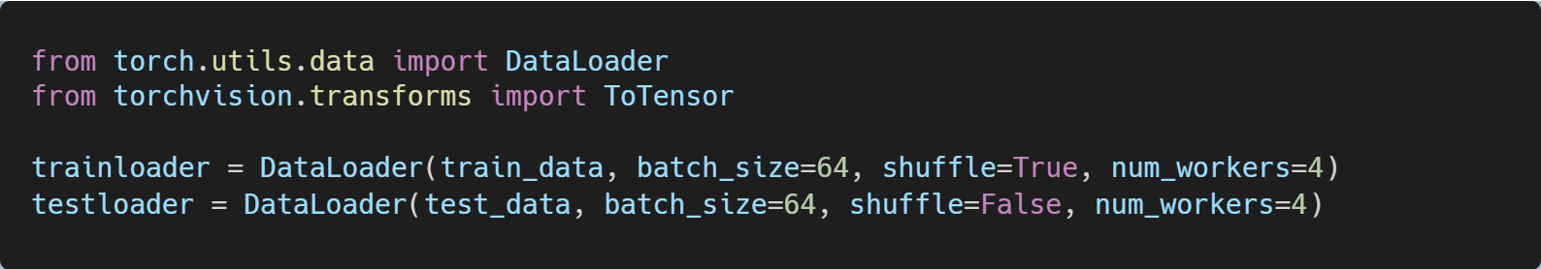
Loader
DataLoader
DataLoader is a utility that helps efficiently load and preprocess data for training or inference.
You can use DataLoader by importing torch.utils.data module.
DataLoader has several parameters, such as dataset, batch_size, shuffle, num_workers and etc.
‘dataset’ is the dataset that you want load using DataLoader.
‘batch_size’ is int variable that size of batches during training or inference.
‘shuffle’ is boolean variable, True, if you want to shuffle the order of dataset else False.
‘num_workers’ is integer variable that for number of threads you want to used. Increasing num_workers is helpful if there is bottleneck in GPU operations.

Slide 16
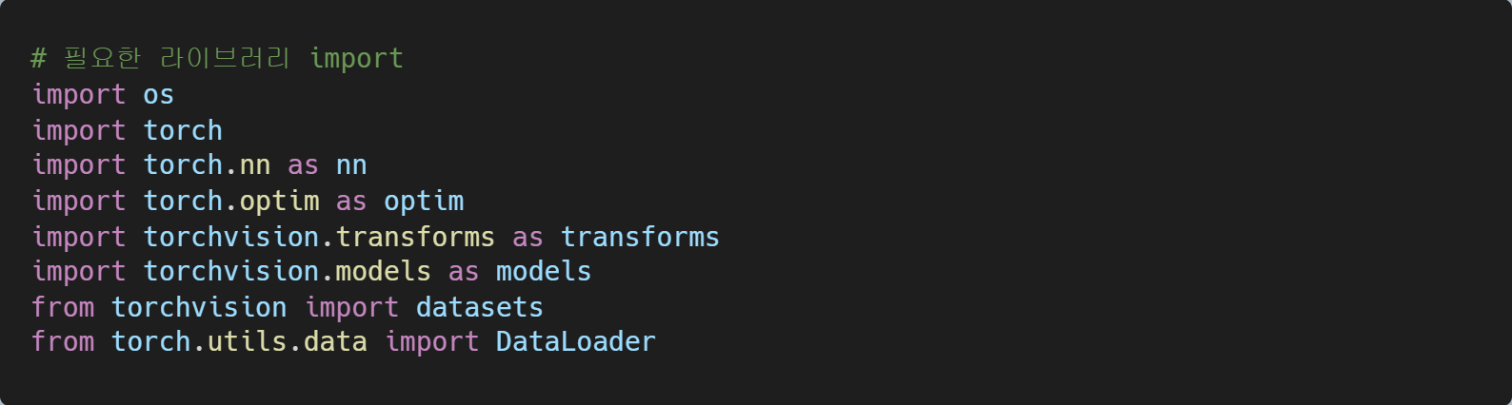
Train & Evaluation
Train From Scratch

Slide 17
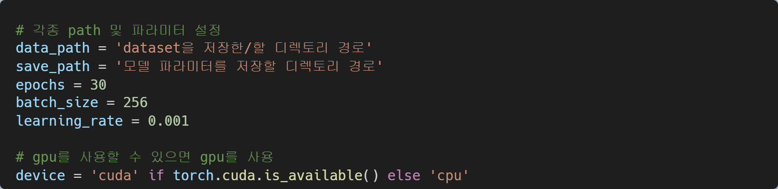
Train & Evaluation
Train From Scratch

Slide 18
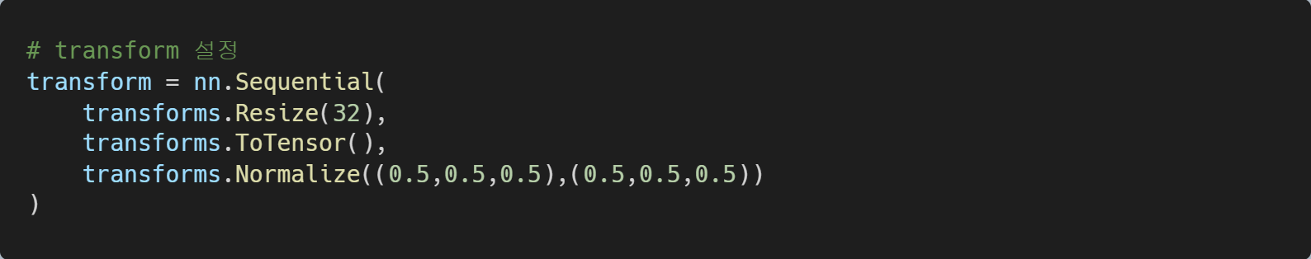
Train & Evaluation
Train From Scratch

Slide 19
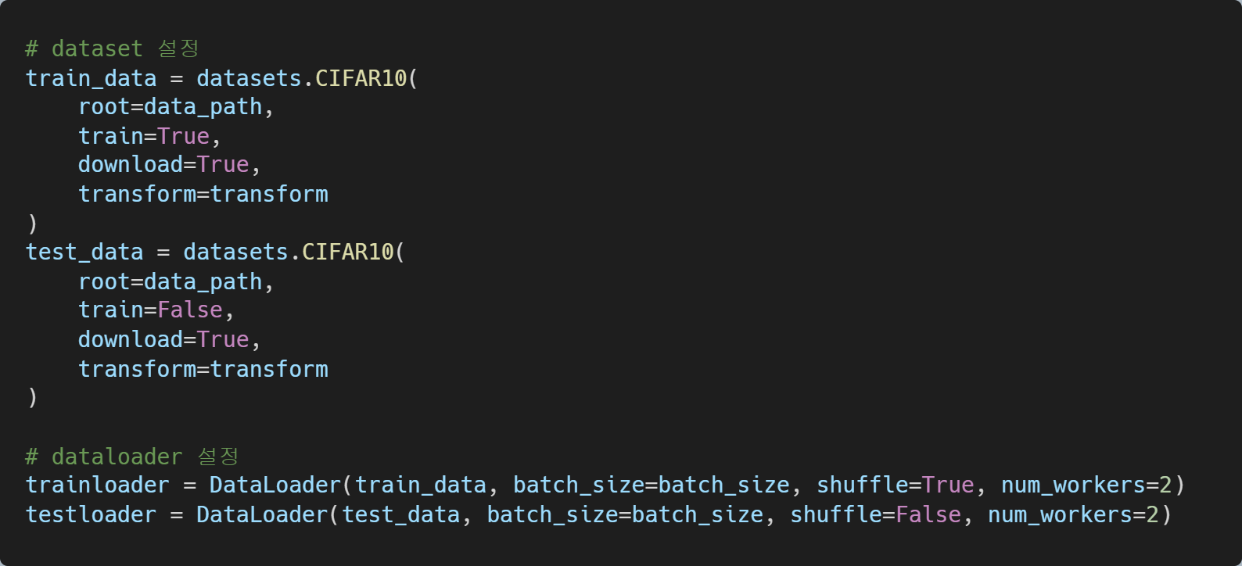
Train & Evaluation
Train From Scratch

Slide 20
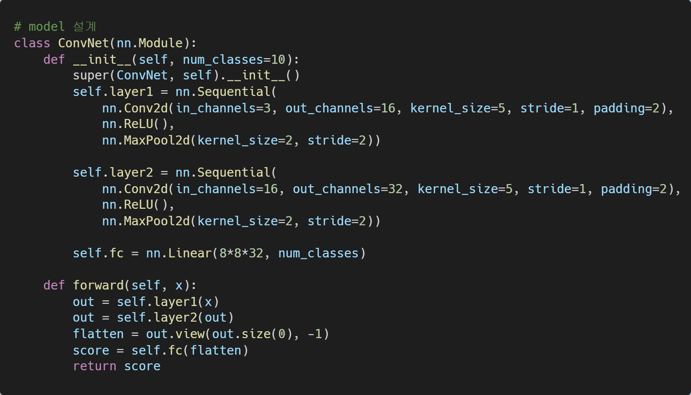
Train & Evaluation
Train From Scratch

Slide 21
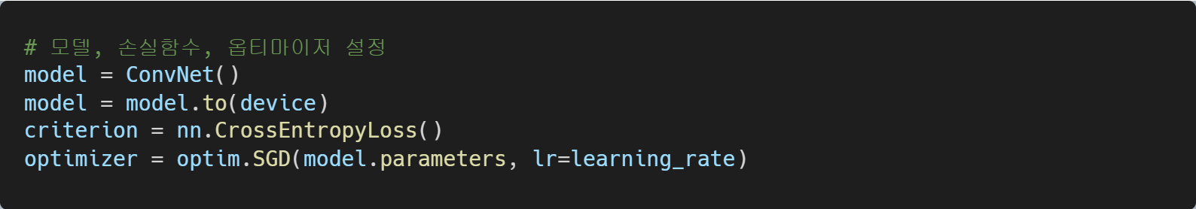
Train & Evaluation
Train From Scratch

Slide 22
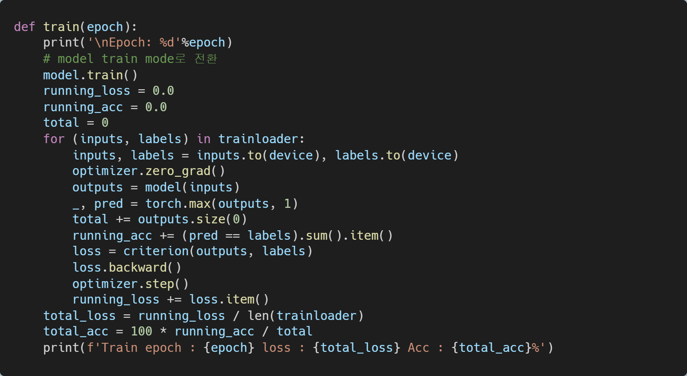
Train & Evaluation
Train From Scratch

Slide 23
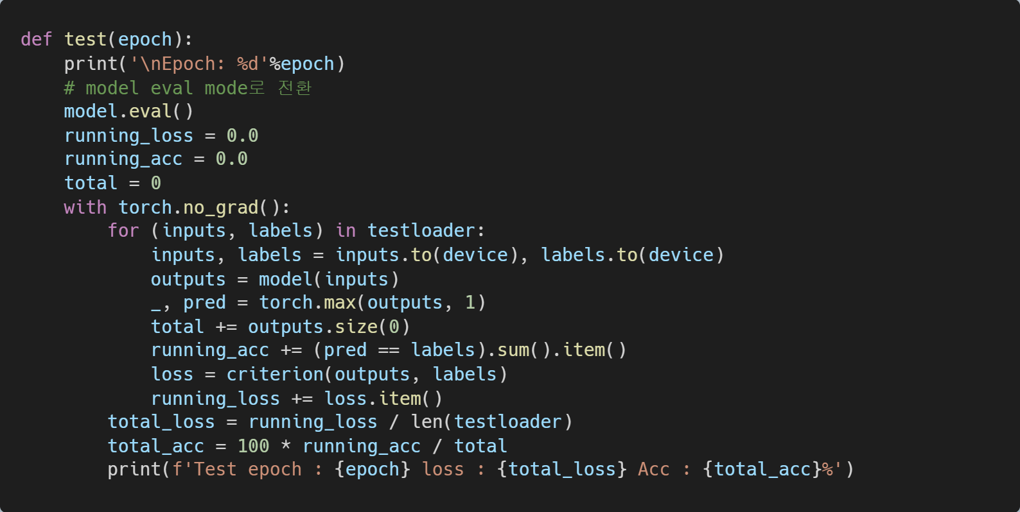
Train & Evaluation
Train From Scratch

Slide 24
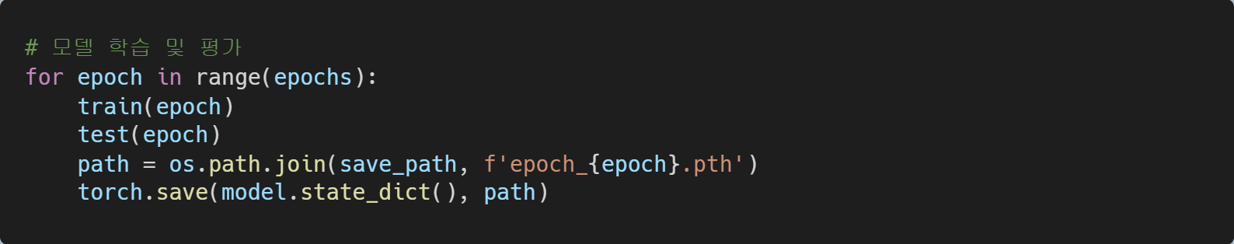
Train & Evaluation
Train From Scratch

Slide 25
Train & Evaluation
Train Predefined Model
Train and Test Again

Slide 26
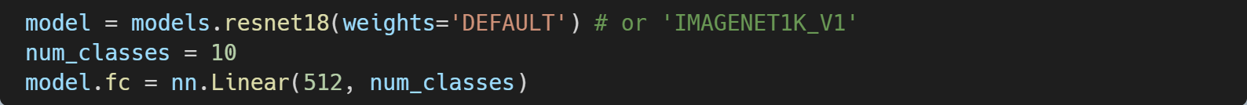
Train & Evaluation
Tuning Pretrained Model
Train and Test Again

Slide 27
Train & Evaluation
Q & A
Make Your Own Custom Model
Please feel free to experiment by adjusting various settings.

Slide 28
Thank You
for Your Attention.

Slide 29
0.0 Appendix
A
B

